Slide 1


ITP/NPV Mini Project
Project-1 [ Loan dataset]
By – Group 1

Slide 2
OUR TEAM
Prajakta
Adhav
SIS ID -
KE5VXB1NF4
Sumit
Gupta
SIS ID -
M0Y8HI76V3
Amey Shendage
SIS ID -
IPO9EXGBA0
Shubham Salvi
SIS ID -
FKSXV8IUQ4
Shivaji Bhabad
SIS ID - ASC9M687PG

Slide 3

LINEUP
1
2
3
4
Introduction & Data description
Required functions and files
Problem Solving
Summary

Slide 4
Introduction
Loans dataset aims to identify variables which indicate if a person is likely to default, which can be used for identifying the risky loan applicants to avoid any financial loss to the company.
Dataset Description :
It contains the complete loan data for all loans issued through the time period of 2007 to 2011.

Slide 5
Data Dictionary
1.annual_inc - The self-reported annual income provided by the borrower during registration.
2.dti - A ratio calculated using the borrower’s total monthly debt payments on the total debt obligations, excluding mortgage and the requested LC loan, divided by the borrower’s self-reported monthly income.
3.emp_length -Employment length in years. Possible values are between 0 and 10 where 0 means less than one year and 10 means ten or more years.
4.funded_amnt - The total amount committed to that loan at that point in time.
5.funded_amnt_inv -The total amount committed by investors for that loan at that point in time.
6.grade - LC assigned loan grade
7.id - A unique LC assigned ID for the loan listing.
8.installment - The monthly payment owed by the borrower if the loan originates.
9.int_rate - Interest Rate on the loan
10.last_pymnt_amnt-Last total payment amount received
11.last_pymnt_d -Last month payment was received
12.loan_amnt -The listed amount of the loan applied for by the borrower. If at some point in time, the credit department reduces the loan amount, then it will be reflected in this value.
13.loan_status - Current status of the loan
14.member_id -A unique LC assigned Id for the borrower member.
15.purpose - A category provided by the borrower for the loan request.
16.term -The number of payments on the loan. Values are in months and can be either 36 or 60.
17.total_acc -The total number of credit lines currently in the borrower's credit
file
18.total_pymnt -Payments received to date for total amount funded
19.total_pymnt_inv -Payments received to date for portion of total amount funded by investors
20.total_rec_int -Interest received to date

Slide 6
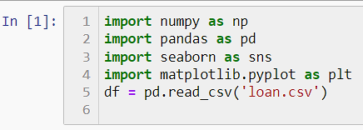
Files and libraries required
Import
Pandas
Numpy
Seaborn
Matplotlib.pyployt
Load dataset
Using Jupyter notebook

Slide 7
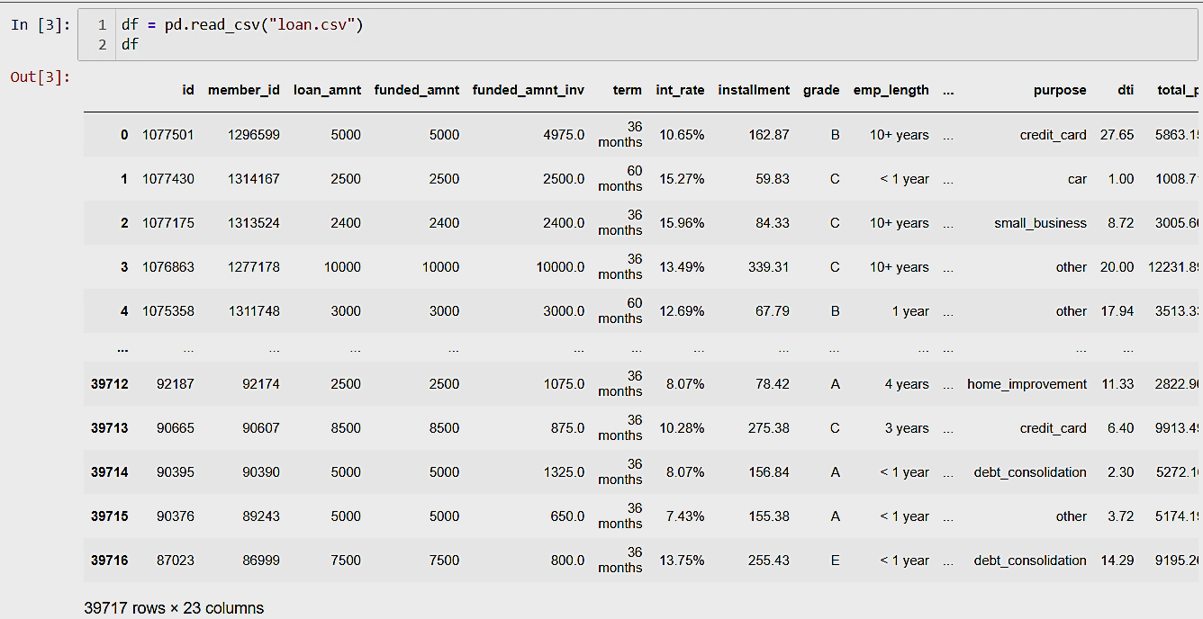
Q1. Import the dataset and understand it.

Slide 8

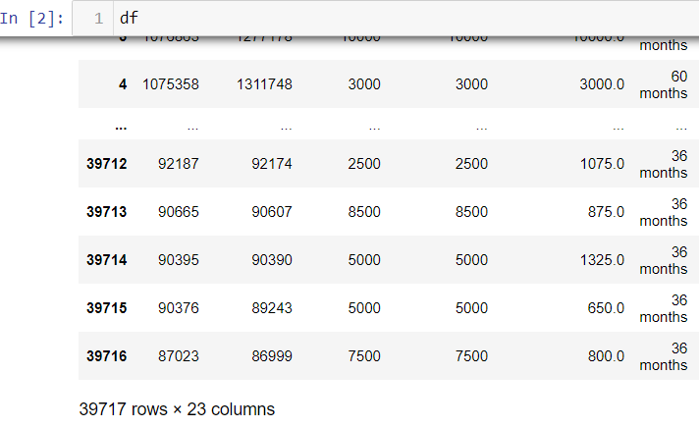
Q2. List down the number of rows and columns
You can also check the left bottom of your data frame

Slide 9
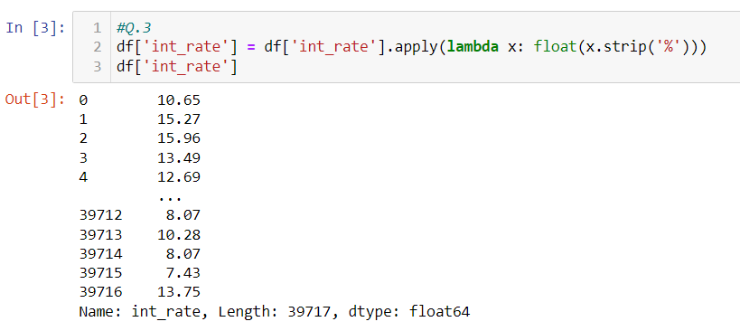
Q3. ‘Int_rate’ column is character type. With the help of lambda function convert into float type.

Slide 10
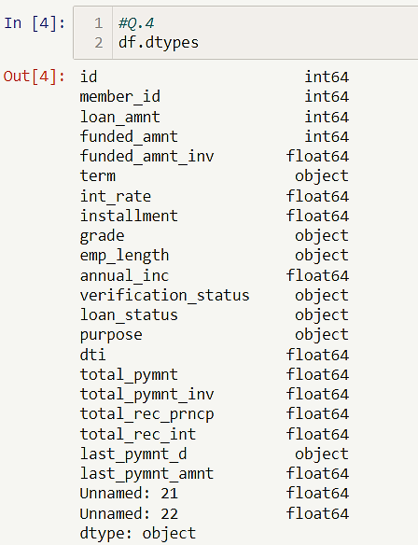
Q4.Check the datatype of each column.

Slide 11
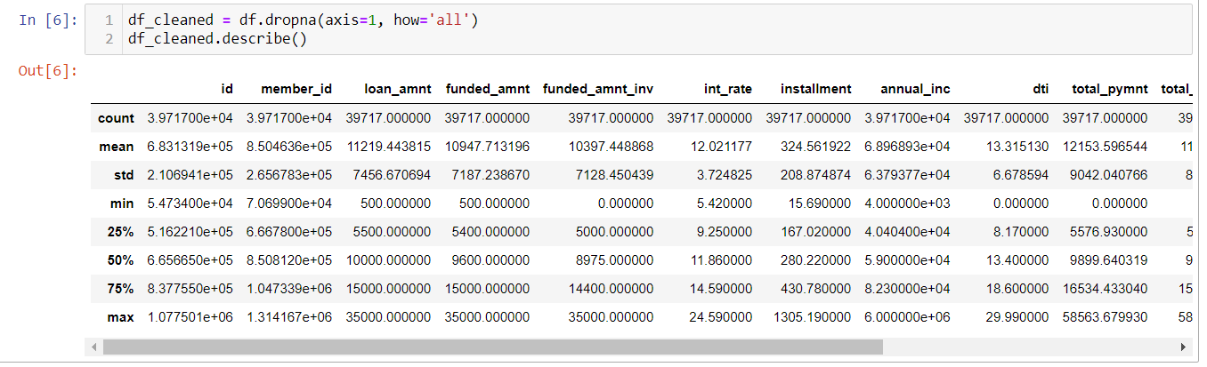
5.Cleaning the dataset- Remove the columns having complete NaN value in the entire dataset.
Now the dataset has no null columns.

Slide 12
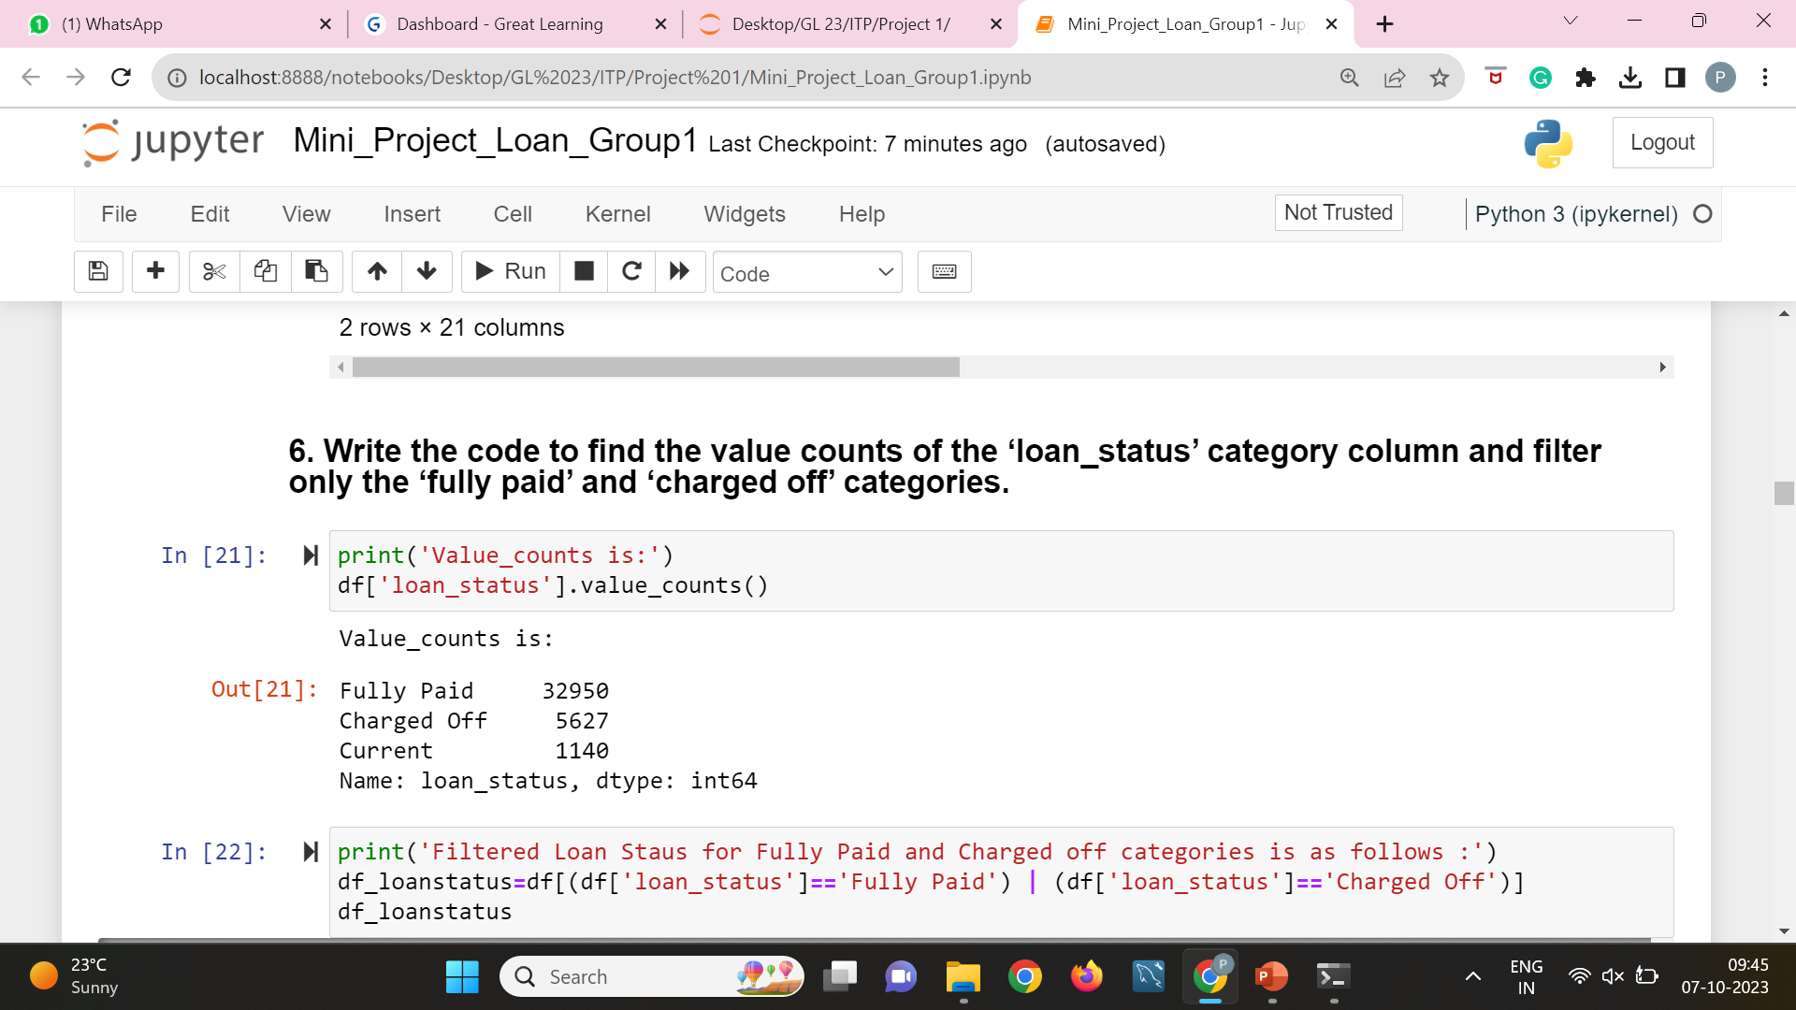
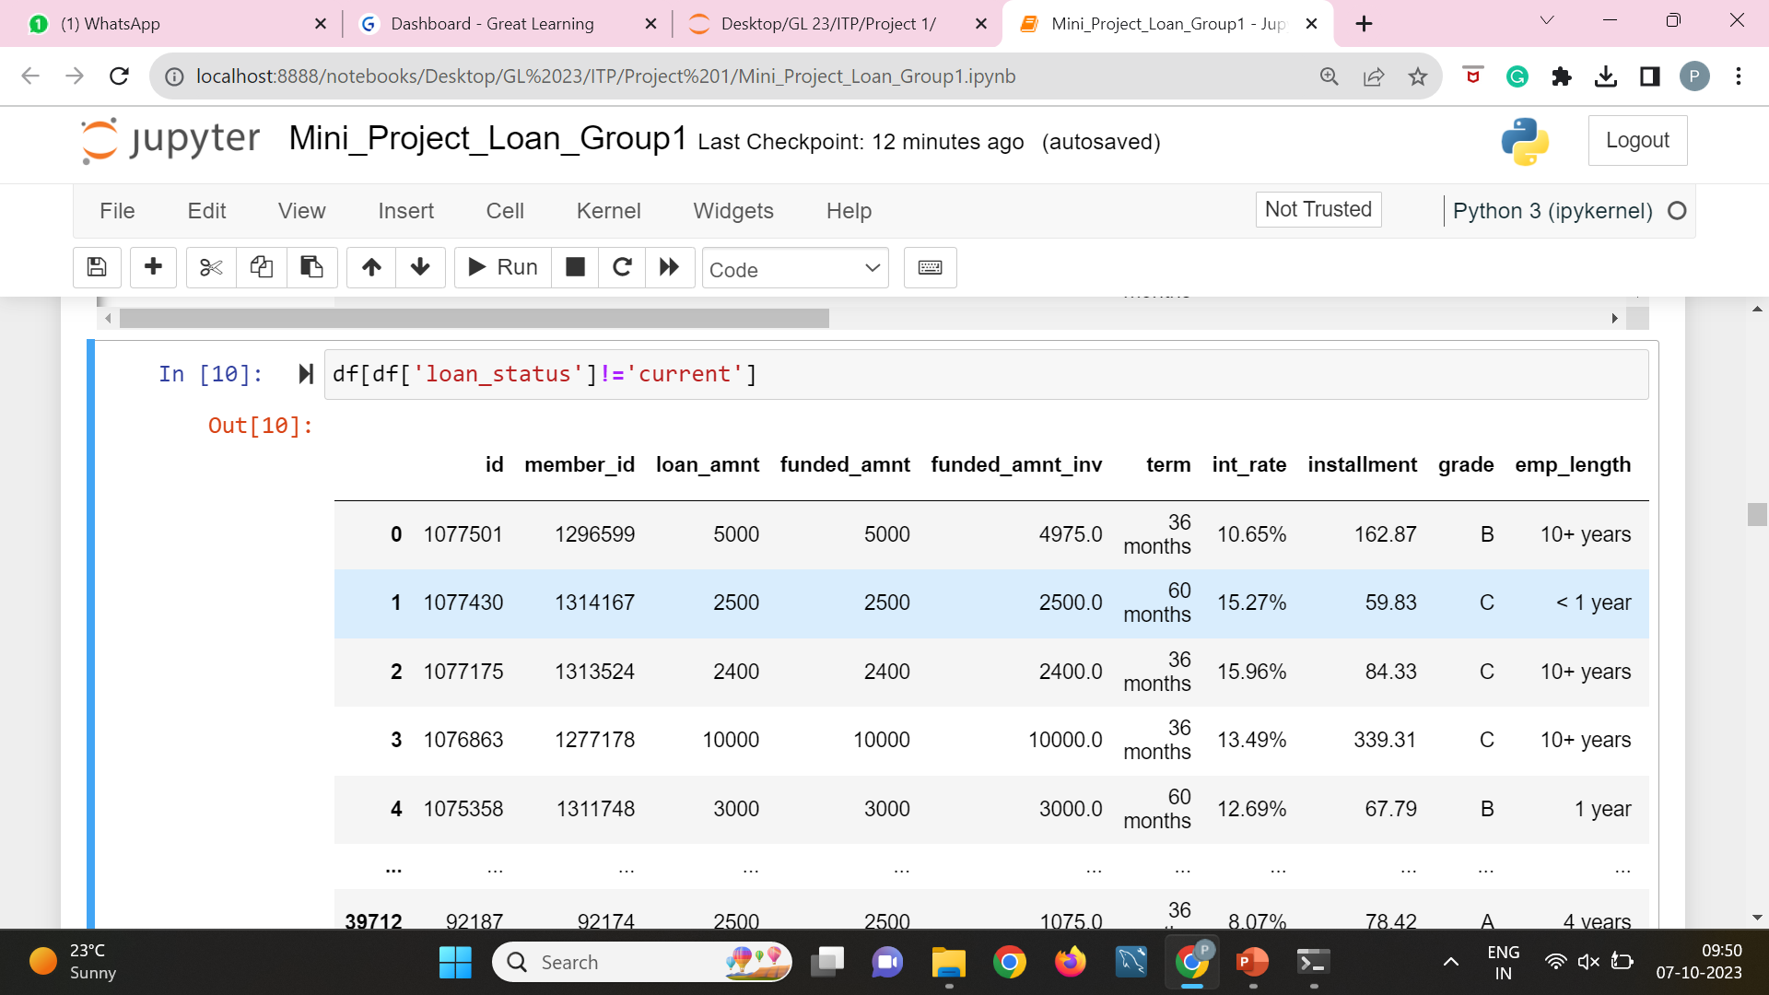
6.Write the code to find the value counts of the ‘loan_status’ category column and filter only the ‘fully paid’ and ‘charged off’ categories.

Slide 13
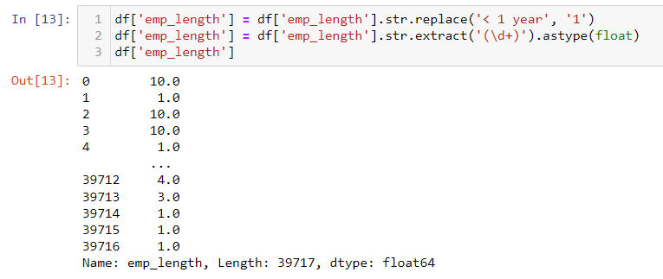
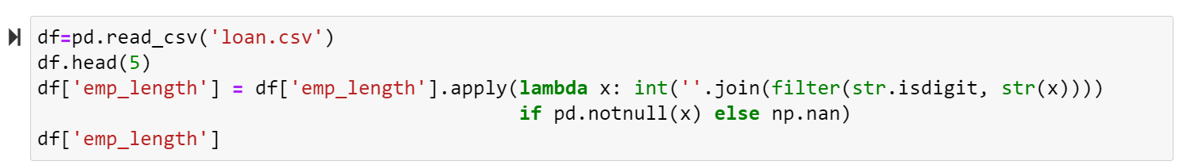
7.Filter the ‘Emp_Len’ column to extract the numerical value from the string. Hint - Emp_len : < 1year, 2 years , 3 years as 1 , 2, 3 so on.

Slide 14
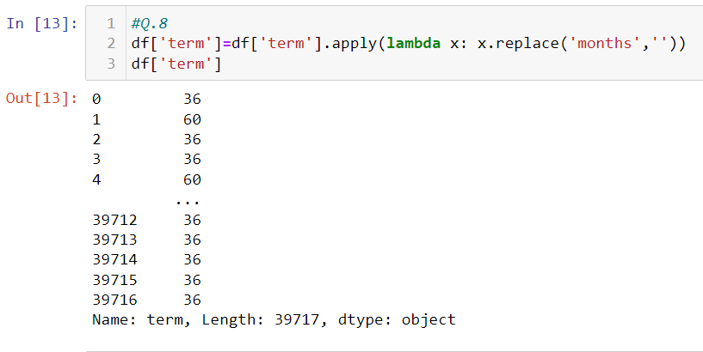
8.Using the Lambda function, remove the month from the ‘term’ column such that ‘36 months’, ‘60 months’ appear as 36 and 60 respectively.

Slide 15
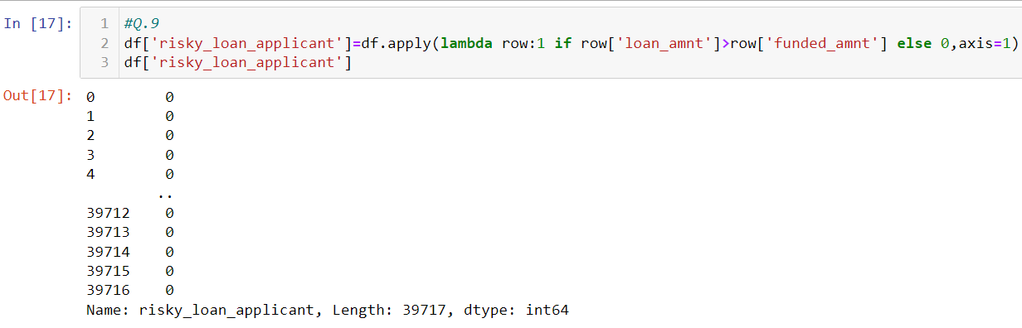
9.Create a new column as risky_loan_applicant by comparing loan_amnt and funded_amnt with the following criteria – If loan_amnt is less than equals to funded_amnt set it as ‘0’ else set it as ‘1’.

Slide 16
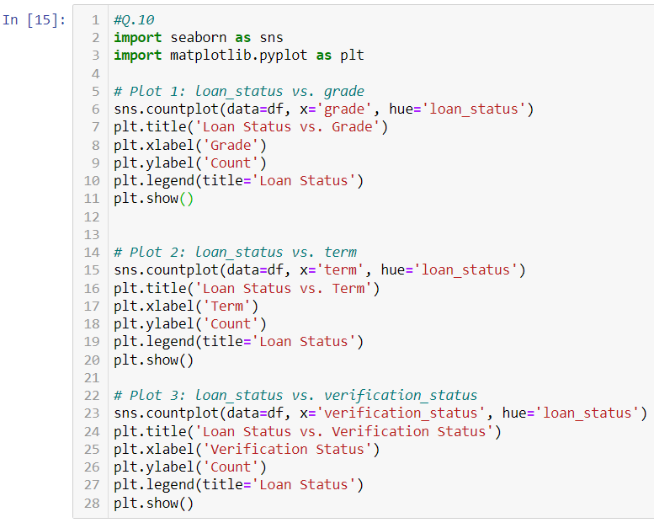
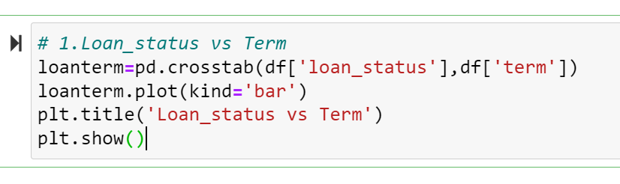
10.Using the bar plot visualize the loan_status column against categorical column grade, term, verification_status .Write the observation from each graph.
## Another approach

Slide 17
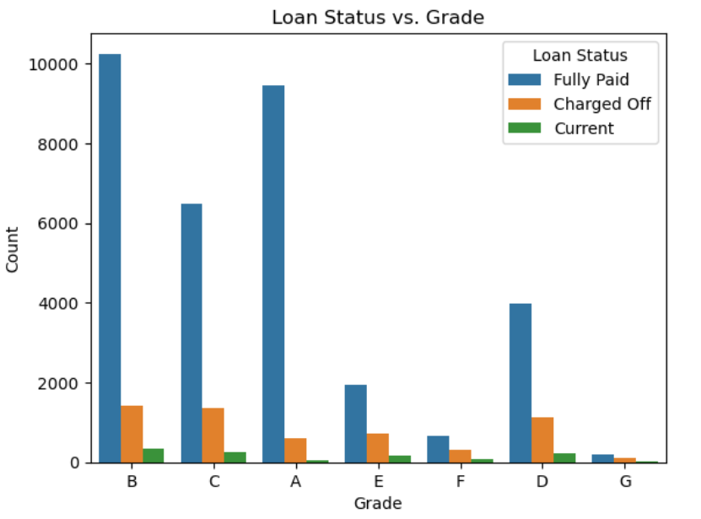
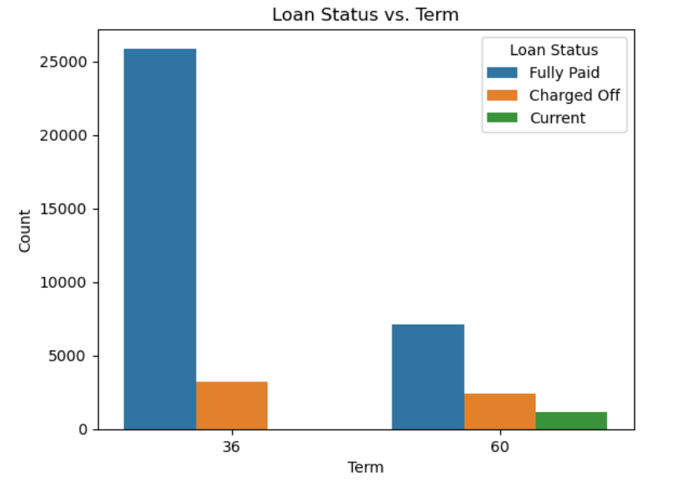
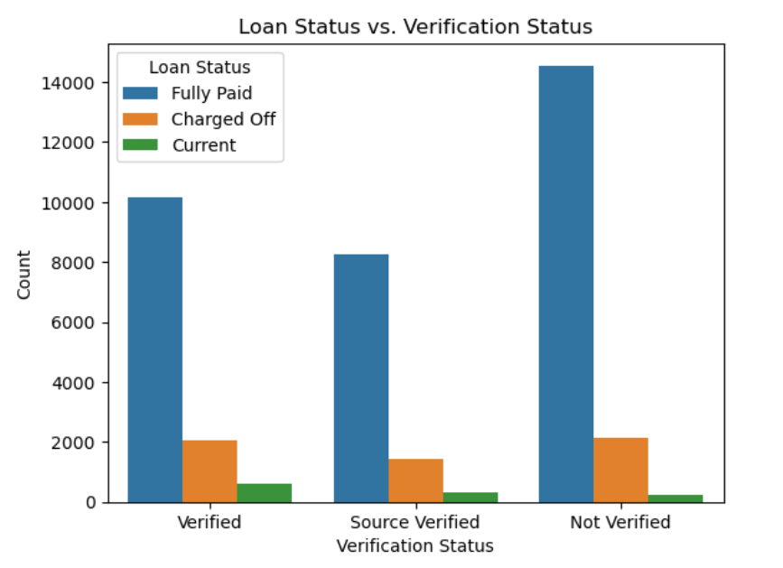
Each graph from Q.10.

Slide 18
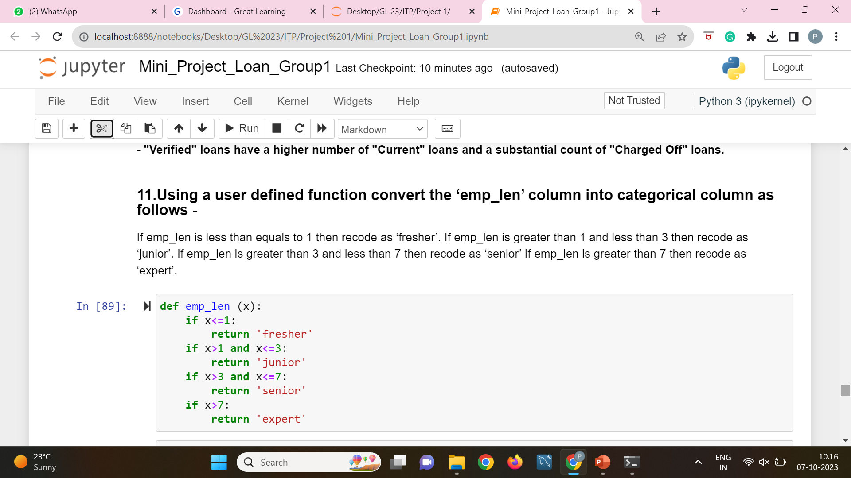
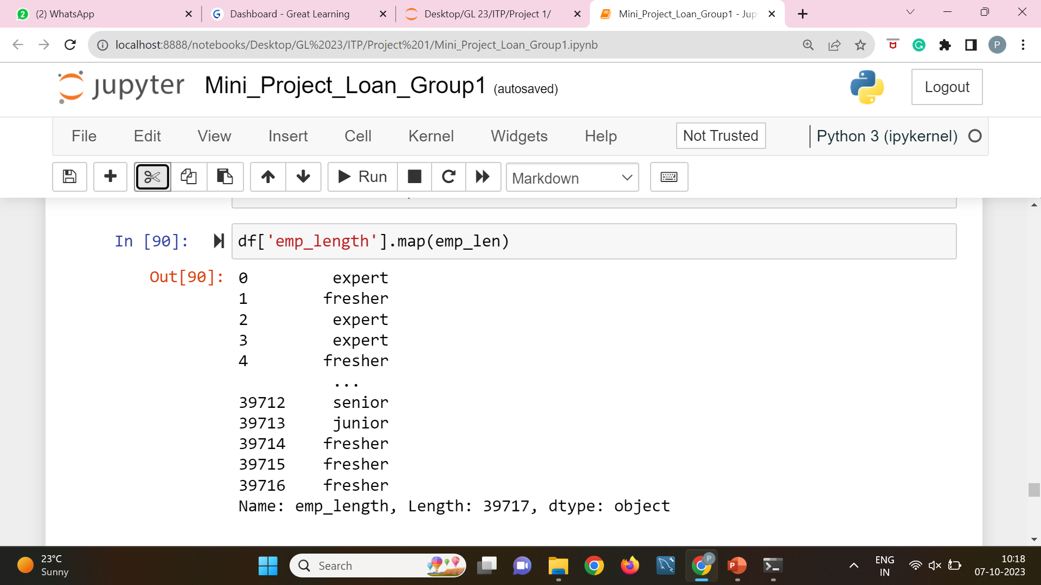
11.Using a user defined function convert the ‘emp_len’ column into categorical column as follows –
If emp_len is less than equals to 1 then recode as ‘fresher’.
If emp_len is greater than 1 and less than 3 then recode as ‘junior’.
If emp_len is greater than 3 and less than 7 then recode as ‘senior’.
If emp_len is greater than 7 then recode as ‘expert’.

Slide 19
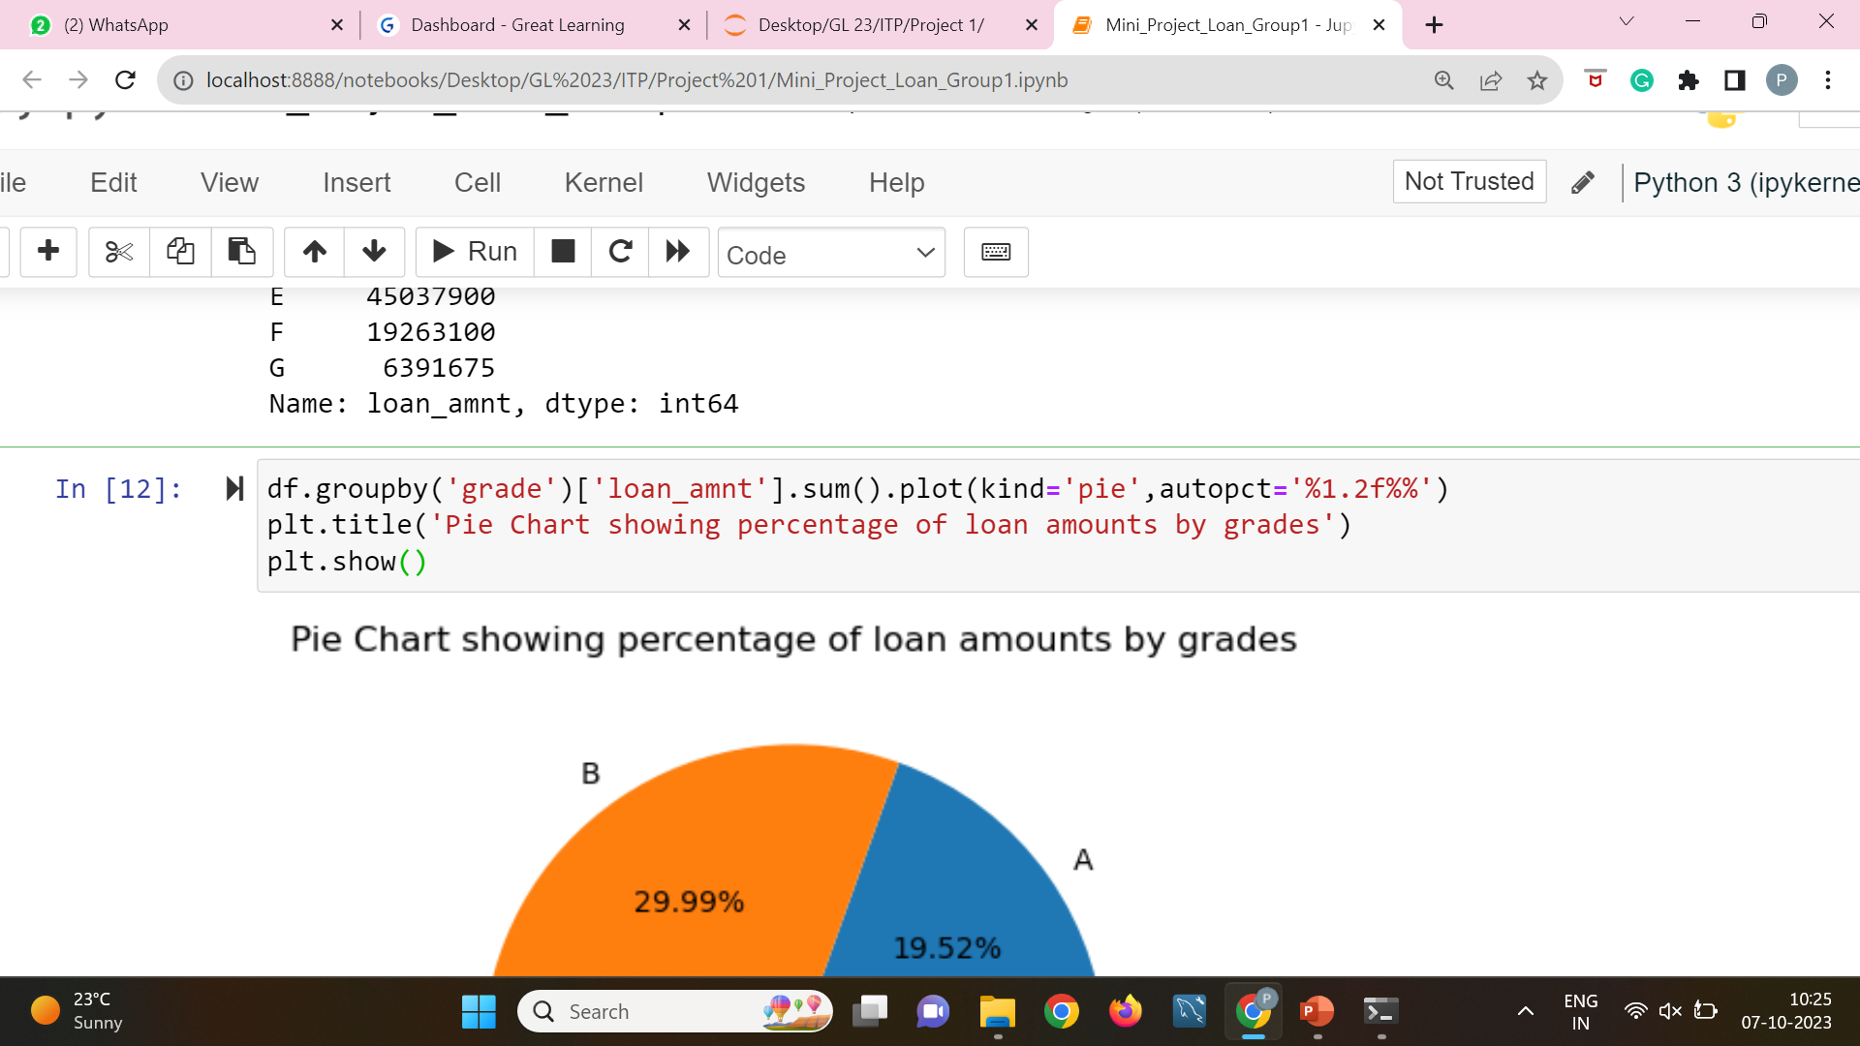
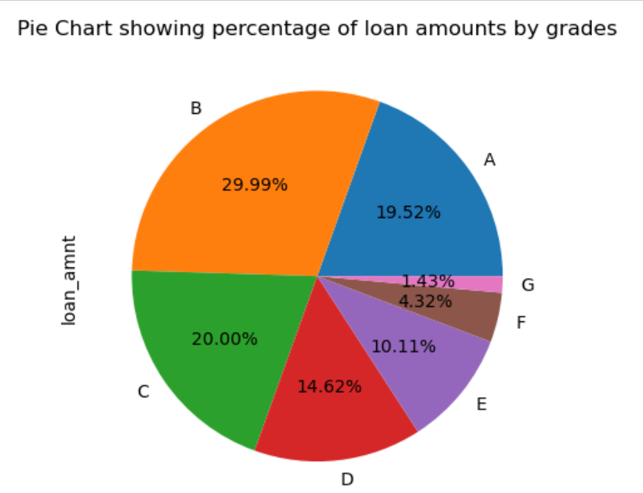
12.Find the sum of ‘loan_amnt’ for each grade and display the distribution of ‘loan_amnt’ using a pie plot.

Slide 20

Thank you
Group-1 ITP-NPV Project

